Slide 1

The Best Review Ever Exam 3 ☺

Slide 2
What you need to know…
….Everything

Slide 3
What can you reasonably know…
….Less than everything

Slide 4
The Solution?
Focus on what you’ve done in homework/quizzes
Know the vocab… I’m not going to go over it here
Practice test – Often questions are based on/copied from these tests
What he emphasizes in the review
Dr. Cook wants everyone to get an A, so pay attention

Slide 5
Conduction stuff
Conduction is like the river
Band Gap
Basic Equations
V = IR
Resistivity: Rho = R*A/length
Conductivity: sigma = 1/rho
What will raise/lower the conduction?
Think of the river
Metal vs Semiconductor

Slide 6
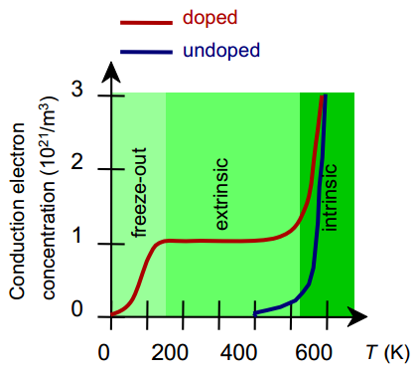
Extrinsic vs. Intrinsic
Intrinsic – Pure Si (n = p)
Extrinsic
N-type (n>>p)
P-type (p<<n)
Sigma = n.i |e| (ue + uh)

Slide 7
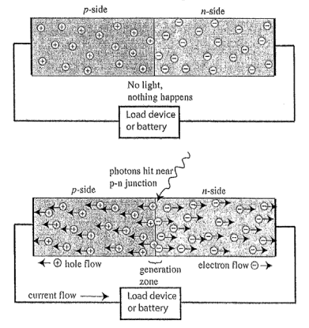
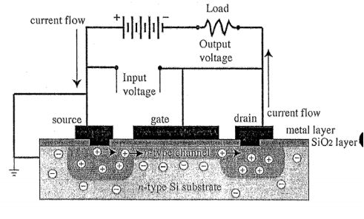
The Useful Stuff
Photomultiplier
MOSFET

Slide 8
Polymers
Know how to calculate the mass/moles necessary to polymerize***
What effect will ____ (fabrication method) have on the strength/ductility/other properties of the polymer
Tg and Tm… what do you want?
Advanced polymers – UHMW PE

Slide 9
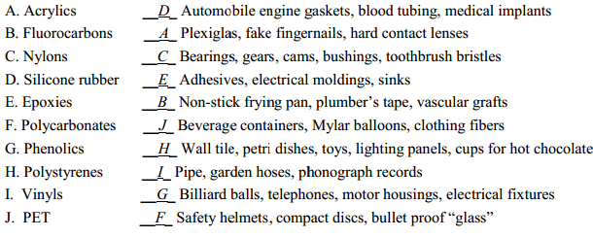
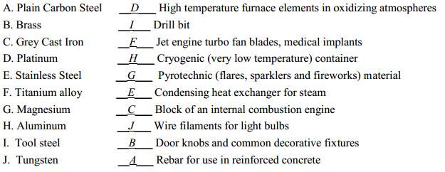
This kind of thing will be there…

Slide 10
Things I would know how to do…
Predict n-type or p-type
Draw MOSFET, solar cell, photomultiplier, etc.
Polymer/Metal matching
Don’t forget all the stress strain stuff

